Slide 1
Data Analytics Challenge
By: Mohamed Hakim
Joe Schweizer
Joe Throne
Pete Mollica

Slide 2
Lockheed Martin Challenge
Goal: Reduce Insider Threat
Provided with employee records (Personal Contact Records, Travel Records, Phone Records, Performance Records, Citizenship Records, and Server Access Logs).
Have to use predictive analysis to provide each employee with a threat level. (Inconsistent phone records, or flight plans)
Identify top potential insider threats, for each department, and company wide.

Slide 3
Approach
Examine each record individually.
Provide an employee a threat level for each record.
Weight each threat level per record accordingly.

Slide 4
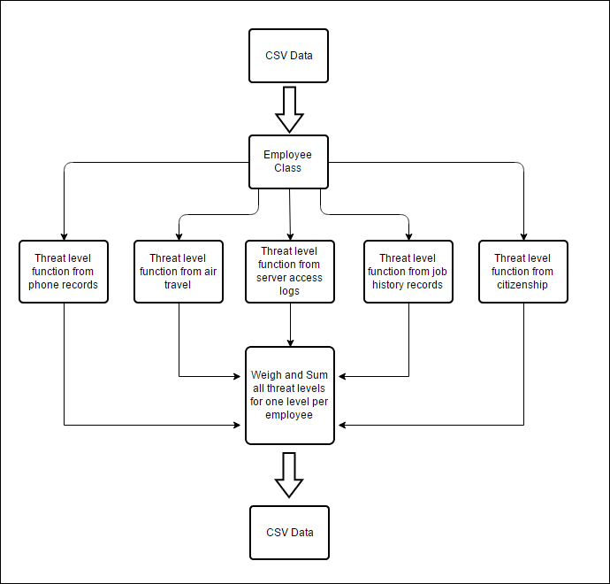
Software Approach

Slide 5
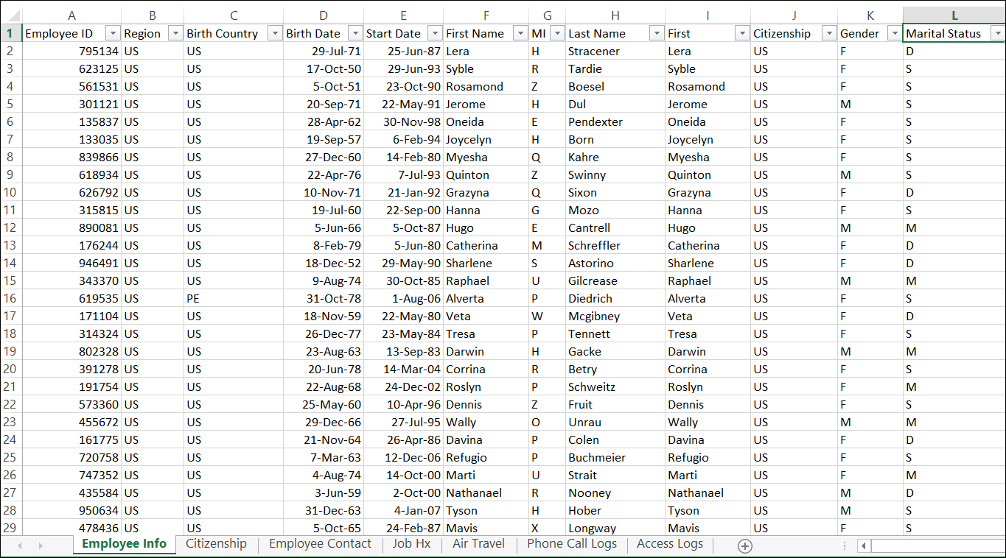
CSV Data

Slide 6
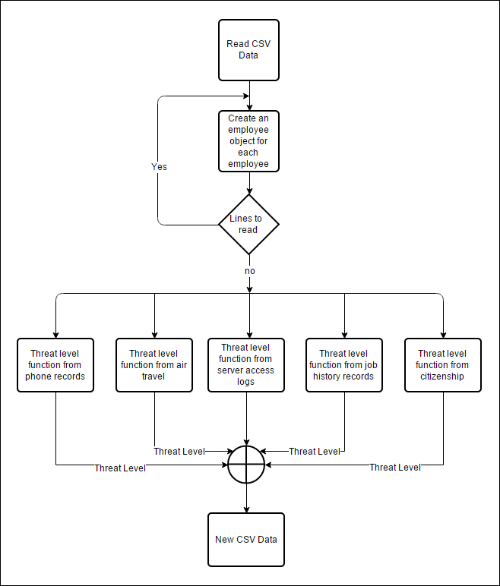
Main Function

Slide 7
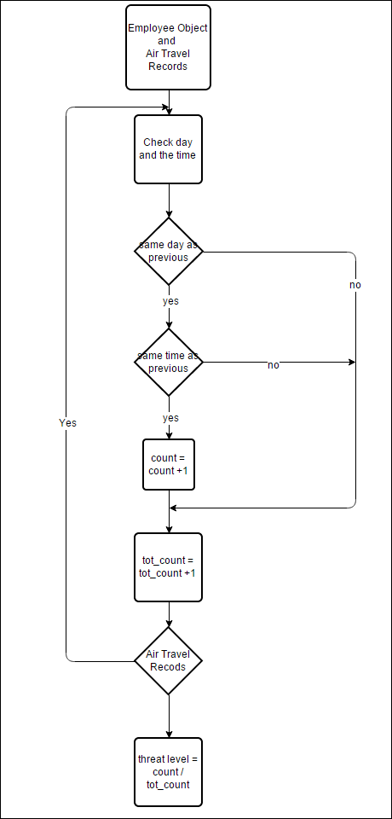
Threat Level: Air Travel

Slide 8
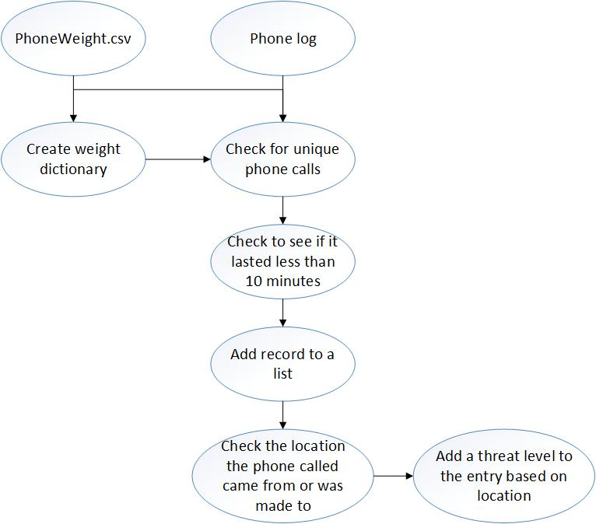
Threat Level: Phone Records

Slide 9
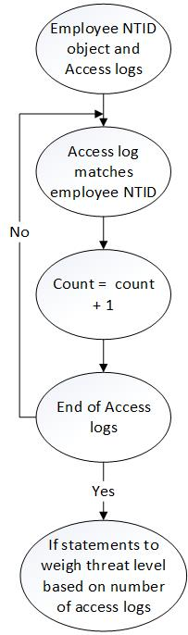
Threat Level: Server Access Logs

Slide 10
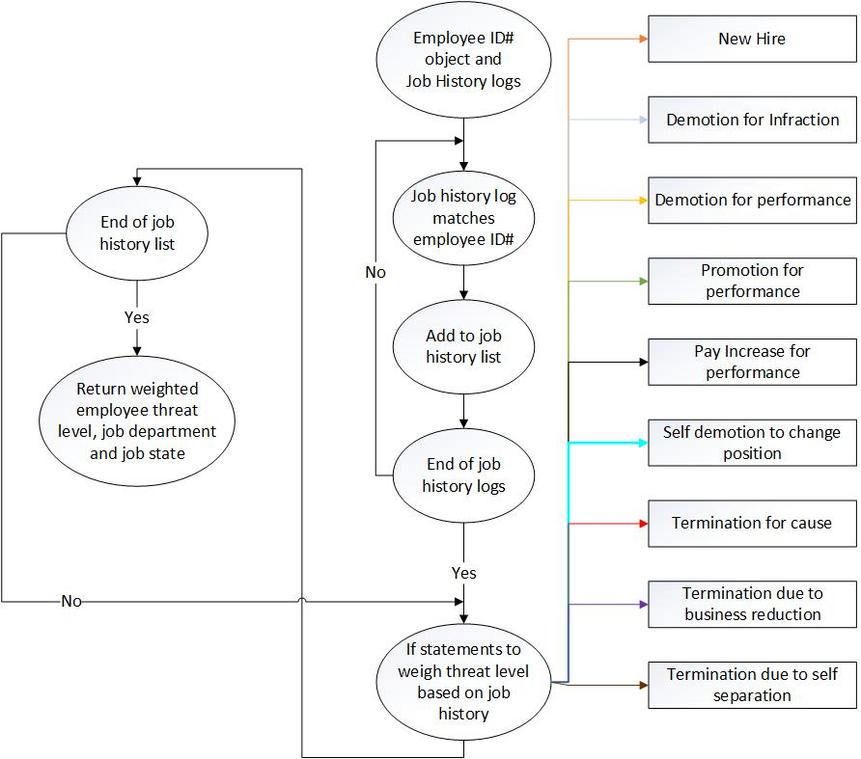
Threat Level: Job History

Slide 11
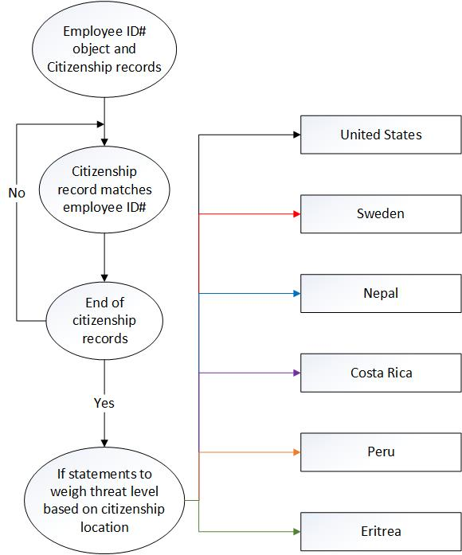
Threat Level: Citizenship

Slide 12
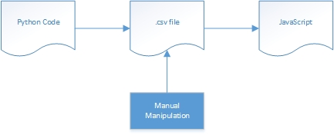
THE END
http://104.131.39.157/

